Slide 1
Naïve Bayes, Bayesian Learning

Slide 2
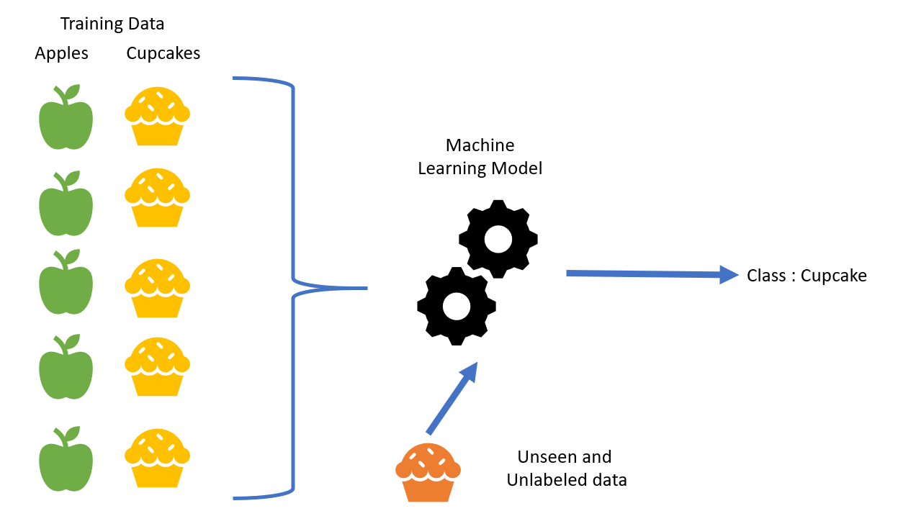
SUPERVISED MACHINE LEARNING
Supervised learning is a form of machine learning in which machines are taught with well-labeled training data and then predict the output based on that data.
In supervised learning, the training data supplied to the machines acts as a supervisor, instructing the machines on how to accurately anticipate the output.
A supervised learning algorithm's goal is to develop a mapping function that will translate the input variable(x) to the output variable(y).

Slide 3


NAIVE BAYES CLASSIFIER ALGORITHM
The Naïve Bayes method is a supervised learning technique for predictive modelling addressing classification issues that is based on the Bayes theorem
Naïve Bayes is a simple and most powerful algorithm for quick predictions
It is mostly utilised in text classification tasks that need a large training dataset.
Naïve Bayes is a probabilistic machine learning method that predicts based on the likelihood of an item occurring.

Slide 4
Why it is said to be Naïve Bayes ?
The two terms Naive and Bayes make up the Naive Bayes algorithm
NAIVE- It is assumed that the features that go into the model is independent of each other. That is, altering the value of one feature has no direct impact on the value of the other characteristics utilised in the algorithm
BAYES- It's called Bayes since it's based on the Bayes Theorem concept
Types of NAIVE BAYES-
1. Gaussian- The Gaussian model implies that characteristics are distributed normally.
2. Multinomial- The Multinomial Naïve Bayes classifier is used when the data is multinomial distributed.
3. Burnoulli- The Bernoulli classifier is identical to the Multinomial classifier, except that the predictor variables are independent Boolean variables.

Slide 5
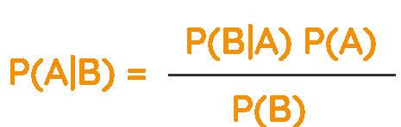
BAYES THEOREM
Bayes theorem is a mathematical formula for calculating the probability of a hypothesis given previous information. It is conditional probability that determines this.
Formula:
Here, P(A|B) is Posterior probability
P(B|A) is Likelihood probability
P(A) is Prior Probability
P(B) is Marginal Probability
The fundamental Naïve Bayes assumption is that each feature makes an:
independent, equal contribution to the outcome

Slide 6
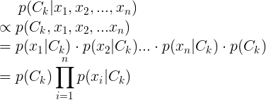
MATHEMATICAL CONCEPT
The goal of Naïve Bayes Classifier is to calculate conditional probability
for each of K possible outcomes or classes Ck.
Let x=(x1,x2,…,xn). Using Bayesian theorem, we can get
Assume that all features x are mutually independent
Hence, the final formula for Naïve Bayes Classifier is:

Slide 7


MATHEMATICAL CONCEPT
Maximum Likelihood Estimation (MLE) is used to estimate parameters — prior probability and conditional probability
The prior probability equals the number of certain cases of y occur divided by the total number of records
Naïve Bayes Classifier uses following formula to make a prediction

Slide 8
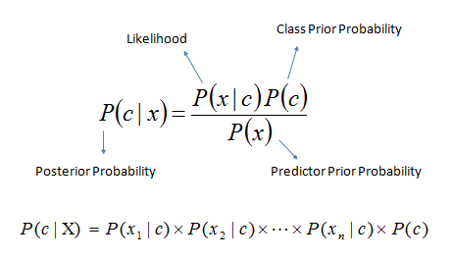
MATHEMATICAL CONCEPT
P(c|x) is the posterior probability of class (target) given predictor (attribute).
P(c) is the prior probability of class.
P(x|c) is the likelihood which is the probability of predictor given class.
P(x) is the prior probability of predictor.

Slide 9
Working of Naïve Bayes Classifier
We need to follow the steps by using dataset to predict the outcomes:
1. Create frequency tables from the provided dataset.
2. Find the probability of given characteristics to generate a Likelihood table.
3. Calculate the posterior probability using Bayes' theorem.
Advantages of Naïve Bayes Classifier:
1. Nave Bayes is a fast and simple machine learning technique for predicting a class of datasets.
2. It's suitable for both binary and multi-class classifications.
3. In comparison to the other Algorithms, it performs better in Multi-class predictions.
4. It is the most often used method for text categorization.

Slide 10

Disadvantages of Naïve Bayes Classifier:
1. Naive Bayes assumes that all features are independent or unrelated, so it cannot learn the relationship between features.
2. The ‘zero-frequency issue' occurs when an algorithm assigns zero probability to a categorical variable whose category in the test data set was not present in the training dataset. To solve this problem, it would be ideal if you utilised a smoothing approach.
3. Shouldn't take its probability outputs seriously since its estimations might be off in some circumstances.
Applications of Naïve Bayes:
1. Text classification
2. Real time predication
3. Spam filtering
4. Sentiment analysis, etc

Slide 11
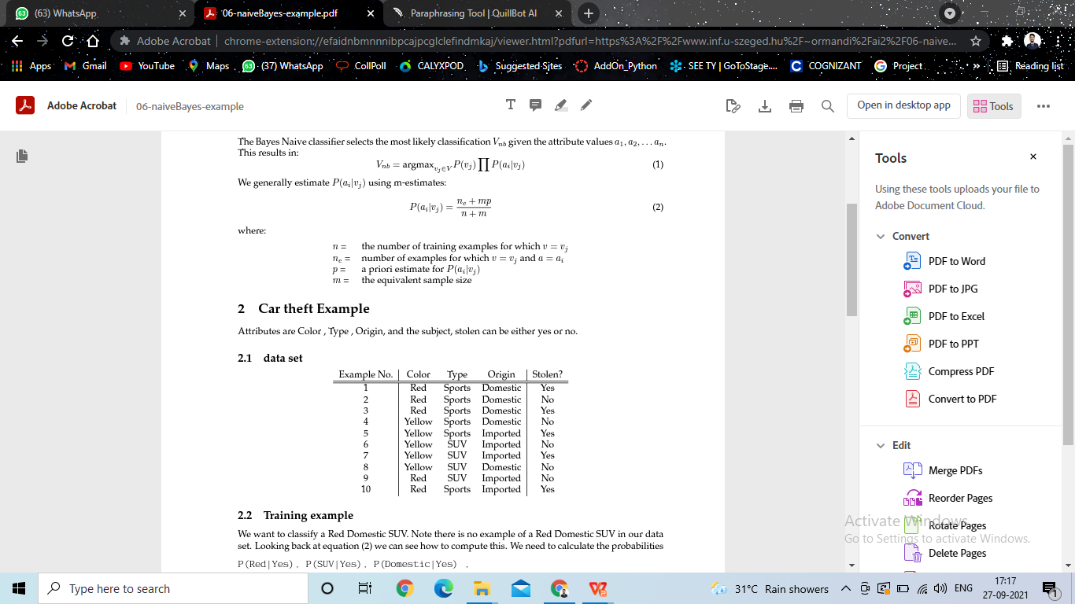
EXAMPLE USING NAIVE BAYES
If we consider CAR THEFT example
Attributes are color,origin,type and subject and stolen is either yes or no
We have to classify the RED DOMESTIC SUV from this data set
But the RED DOMESTIC SUV is not present in our set
Hence, we can calculate probabilities of
P(Red|Yes), P(SUV|Yes), P(Domestic|Yes) , P(Red|No) ,
(SUV|No), and P(Domestic|No)
and multiply them by P(Yes) and P(No) respectively
We get
P(Red|Y es) = 3+3∗0.5 /(5 +3) =0.56
P(Red|No) = 2+3∗0.5 /(5 +3) =0.43
P(SUV|Yes) = 1+3∗0.5/(5 +3) =0.31
P(SUV|No) = 3+3∗0.5/(5 +3)=.056
P(Domestic|Y es) = 2+3∗0.5 /(5 +3)=0.43
P(Domestic|No) = 3+3∗0.5/(5 +3) =0.56

Slide 12
We have P(Yes)= 0.5 and P(No)= 0.5
For Yes;
P(Yes) * P(Red | Yes) * P(SUV | Yes) * P(Domestic|Yes)
=0.5 *0 .56 *0 .31 *0 .43 = 0.037
For No;
P(No) * P(Red | No) * P(SUV | No) * P (Domestic | No) =
0.5 *0.43 * 0.56 * 0.56 =0.069
Thus, As probability of NO is greater than that of Yes
0.069>0.037
Hence, our example i.e., RED DOMESTIC SUV will be classified as “NO”

Slide 13


REVIEW OF RESEARCH PAPER Analyzing Diabetic Data using Naive-Bayes Classifier

Slide 14
PROBLEM STATEMENT
The main aim of the research is how much percentage of patients are prone to or have diabetes, as a set of positive and negative information using the MapReduce theorem, Naive Bayes classifier, and J48 decision tree.
INTRODUCTION-
Diabetes causes high blood sugar levels in an individual.
Diabetes can be broadly categorized into four types: Type 1 , Type 2 , Pre-diabetes and Gestational Diabetes.
Diabetes can be predicted or diagnosed by some of the common symptoms like increase in hunger, increased thirst, loss of weight, blurred vision, extreme tiredness.
Type 1 Diabetes can be prevented by insulin treatment.
Type 2 Diabetes can be prevented by changing diet and exercising.
Gestational diabetes can be prevented by taking care of diet and blood sugar levels.

Slide 15
The data taken is categorized into Training data and Test data.
The training data contains information on a large number of patients, as well as the projected outcome of whether or not the patient has a diabetes risk.
Test data is where implementation works and hence predicts that a person has a risk of diabetes or not.
The categorization of the details of a patient on the basis of attributes that are considered for prediction of risk of diabetes.
This classifies the data according to the attributes specified and hence implements using probabilistic characters.
Hence the result we get is in the form of probability whether the person has diabetes or not.

Slide 16
The attributes that are categorized for the prediction of the risk
level of Diabetes.
Features:
1. Glucose
2. Body Mass Index (BMI)
3. Diabetic Pedigree's Role
4. Blood Pressure
5. Age
6. Insulin
7. Thickness of the skin
8. Pregnancies

Slide 17
NAIVE BAYES ALGORITHM
Naive Bayes is a classifier that produces outputs with a probabilistic nature, i.e. the likelihood of something happening.
When the details of a patient are input into all respective attributes, such as age, blood pressure, and so on.
Naive Bayes calculates the individual probability of each attribute and therefore defines a range for each attribute.
After that, it classifies and compares each characteristic range, resulting in a probability-based result indicating whether or not a person is at risk for diabetes.
Glucose levels, BMI, weight, age, blood pressure levels, and hormone levels are all aspects to consider. For parameter estimation, this classifier requires a very little amount of training data.

Slide 18
By Bayes' theorem, the conditional probability is formulated
p(Ca | Z) = p(Ca) p(Ca|Z) / p(Z)
where,
p(Ca | Z)=posterior probability
p(Ca|Z)= Likelihood
p(Ca)= Class Prior Probability
p(Z)=Predictor Prior Probability
Equation can be written as-
POSTERIOR=PRIOR*LIKELIHOOD/EVIDENCE

Slide 19
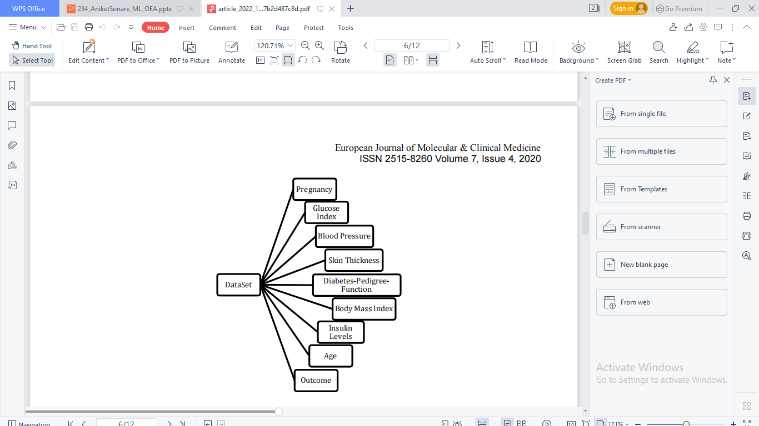
DATASET CLASSIFICATION

Slide 20
CLASSIFICATION RATE/ACCURACY
Accuracy(X)=tPo + tNe / tPo + tNe + fPo + fNe
Where,
1. Positive or Po: Positive observation.
2. Negative or Ne: Negative observation
3. True Positive or tPo: Observation is positive as well as it has been predicted to be positive.
4. False Negative or fNe: Observation is positive, but it has been predicted to be negative.
5. True Negative or tNe: Observation is negative as well as it has been predicted to be negative.
6. False Positive or fPo: Observation is negative, but it has been predicted to be positive.

Slide 21
DATASET
A dataset is a collection of connected sets of data that are made up of discrete
pieces that may be modified according to the requirements. The dataset for this study
came from the UCI Machine Learning Repository.
The dataset is classified as-
1. Glucose: Normal - Pre-Diabetic – High
2.Blood Pressure: Normal – High
3. Body Mass Index: Ideal – Overweight
4. Diabetes Pedigree Function: Likely – Unlikely
5. Age: Adult - Middle Aged – Elderly

Slide 22
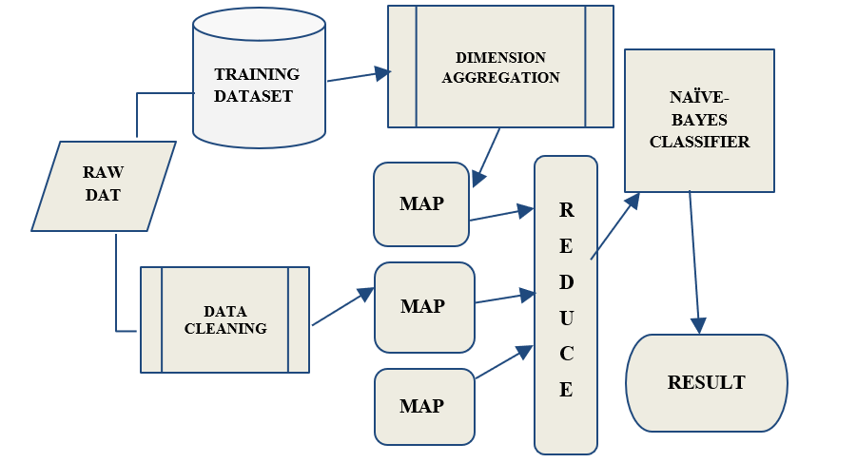
DIABETES DATA ANALYSIS

Slide 23
IMPLEMENTATION-
The procedure begins with data gathering and the creation of an analytical dataset.
After the dataset is created, it goes through a data cleaning and dimension aggregation procedure.
After the non-useful data has been removed, the MapReduce Theorem is applied.
As a result, following all of the cleaning and reduction, the confusion matrix was used to assess departure from predicted values based on the data given.
By NAIVE BAYES Algorithm
p(Ca | Z) = p(Ca) p(Ca|Z) / p(Z)
The result gives the likelihood of Diabetes Diagnosis as a Probability (≤1). The Outcome 0 means that the patient is Non-Diabetic. If the outcome is 1, the result is positive for Diabetes.

Slide 24
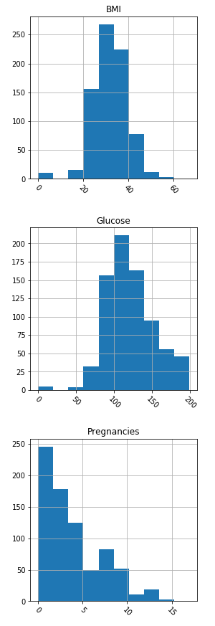
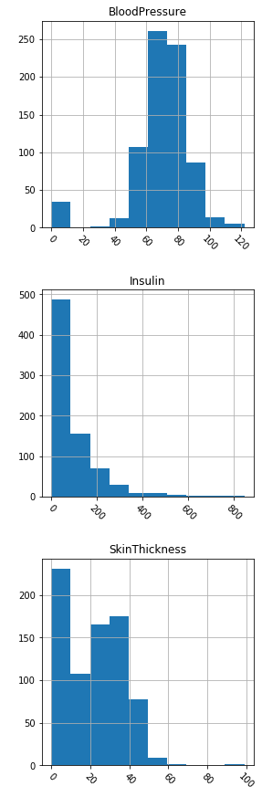
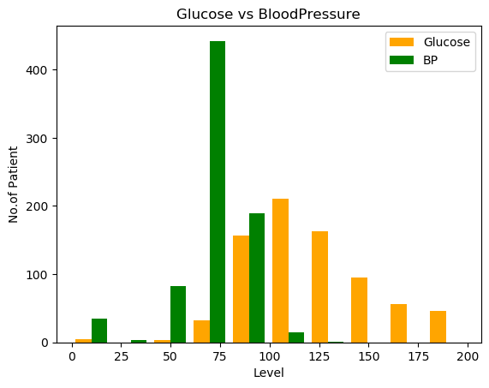
ANALYSIS & STUDY
X-axis: Level; Y-axis: No. of Patients

Slide 25
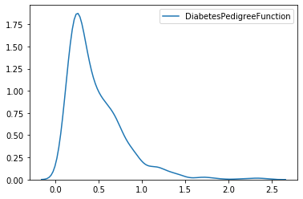
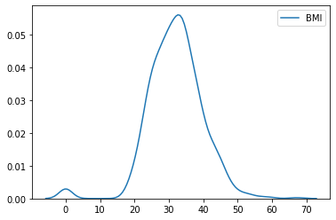
TIME PLOT OF DIABETIC PEDIGREE TIME PLOT OF BMI
FUNCTION

Slide 26
PARAMETERS
For the Bayes classifier,we need to learn two functions, the likelihood and the prior.
The problem with the explicitly modeling is that there are usually many parameters:
-We’ll run out of space
-We’ll run outof time
- We’ll need tons of training data whoch is usually impossible

Slide 27
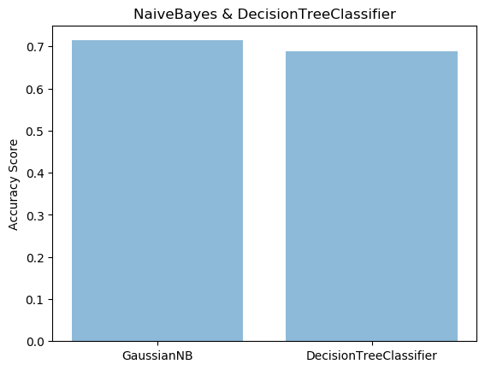
COMMENT ON RESULTS OF RESEARCH PAPER
In this paper the accuracy was about 70% for Naive Bayes and 67% for decision tree
classifier which seems that Naive Bayes classifier have more accuray as compared to
decision tree.
Naive Bayes being a classification algorithm is fast,secure, easy to adapt and provides accurate results.
This research work focuses widely on the methodological approach of Naive Bayes
Classifier to detect diabetes accurately and precisely.

Slide 28
CONCLUSION
Naive Bayes Classifier is a methodological technique for correctly and precisely detecting diabetes.
As a classification algorithm, this approach is quick, secure, easy to change, and produces accurate results.
By improving accuracy, it can be beneficial in medical research, and a mobile application based on these discoveries can be developed to make it more accessible to general users and users at risk of acquiring diabetes.

Slide 29


